Slide 1

Designing Albuquerque:
An Open House for Architects, Landscape Architects & Engineers

Slide 2
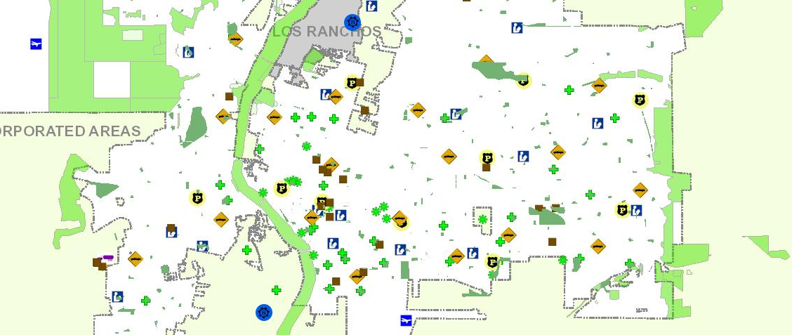
Why are you here today?
Map of City Facilities

Slide 3
Inventory of City Properties
2.2 Million Sq./ft Managed by Facilities
Airport
4 Museums
Bio Park
2 Performing Art Centers
23 Community Centers
18 Libraries
12 Pools
298 Parks
30,000 acres of Open Space
153 Miles of paved trails
4,668 lane miles of roadway
765 miles of storm drain pipe
32,436 storm drain inlets
110 drainage ponds
12 dams
200 bridges
80 miles of arroyos
658 Signals

Slide 4
How Much Does the City Spend on Design and Construction
Construction Funding Sources
General Obligation Bonds
Federal Grants (Transportation, CDBG, Aviation, EPA?)
1/8 and ¼ Cent Tax Increase for Bio Park and Transportation
State Grants
GRT Bonds

Slide 5

Selection Advisory Committee (SAC) Process
Advertisement (RFP) and proposals
There are 2 types of projects: On-Call and project specific
  On-Call projects oftentimes have multiple awards
Advertisement for projects
  Projects advertise on Wednesdays (DMD website and Albuquerque Journal).
  Projects that advertise for 3 weeks have federal funding and Point Deductions are not applied.
  Projects that advertise for 2 weeks do not have federal funding and Point Deductions are applied.

Slide 6

Selection Advisory Committee (SAC) Process
Advertisement (RFP) and proposals
Pay close attention to the category weights, they change on every project.
Know your audience, who scores proposals?
  The SAC Committee scores proposals.
  There are 5 members on the SAC Committee.
  2 (minimum) of the 5 members are licensed professionals in the field of solicitation (RA, PLA, or PE).
  1 is the project manager who may or may not be one of the licensed professionals.
  2 are COA employee who are familiar with the project or have a high stake in the project; could be a Deputy Director, Division Manager, etc.

Slide 7

Selection Advisory Committee (SAC) Process
Advertisement (RFP) and proposals
Be sure to read the RFP and your proposal thoroughly to make sure all the technical details are taken care of: signature on a Pay Equity Form, inclusion of all the required documents, page numbering, size of document, etc.
Projects affected by Point Deductions have proposals due as close to after the 1st of the month as possible, to allow for possible Point Deductions to “fall off”.

Slide 8
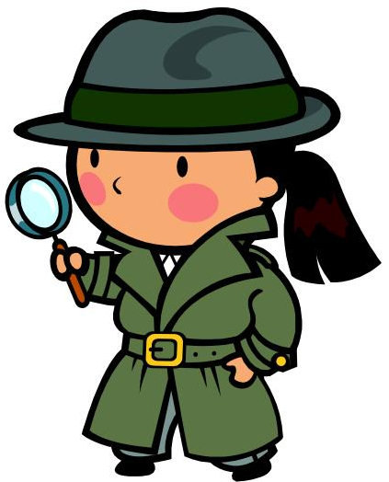
Selection Advisory Committee (SAC) Process
Advertisement (RFP) and proposals
What do we look for in your proposals?
Proposals should be clear and concise: hence, easy to follow.
Read the Request for proposal and scoring criteria very carefully! Seems simple right?
Answer the questions as truthfully and thoroughly as you can, even if you don’t have germane, extensive, or current experience with the City of Albuquerque.
The proposal should match or relate to the work requested. If it is for an On-Call then presenting multi-million dollar projects isn’t relevant. Present similar work.

Slide 9
Selection Advisory Committee (SAC) Process
Advertisement (RFP) and proposals
What do we look for in your proposals?
Make sure the project experience listed is relevant and in scale with the proposed project, and that relevance is clarified in the proposal.
Tailor your response to the needs of your user group. Be prepared to be a good listener.
Past history with the firm. What kind of work experience is there with the A/E? Are they timely with their work? Is there a lot of redesign and are there a lot of RFIs in the Construction phase?

Slide 10
Selection Advisory Committee (SAC) Process
Advertisement (RFP) and proposals
What do we look for in your proposals?
Staffing. If the proposal for an On-Call shows a couple of principals in the work chart and little is provided on the staff then I think, “Really…the principal will be working on the project?”
Indicating that an un-licensed individual will be working as the project architect or PM doesn’t set well either, especially when it is a larger project.
Assure team members should have project specific experience.
Make sure the team is “tailored” to the specifics of the proposed project throughout its content.

Slide 11
Selection Advisory Committee (SAC) Process
Advertisement (RFP) and proposals
What do we look for in your proposals?
The firm should clearly state roles and responsibilities of the team members and define the inter-relationships with the stake holders.
Respondents often fail to identify a Principal A/E registered in the State of New Mexico, this is required and it maintains continuity for the project. Respondents are encouraged to further define the responsibilities of those individuals in key roles tailored to the project.

Slide 12
Selection Advisory Committee (SAC) Process
Advertisement (RFP) and proposals
What do we look for in your proposals?
Although it is important…Fiscal Responsibility, and Cost Control is not about how you manage your staff and your consultants. How will you go about creatively and skillfully addressing the scope-budget landscape for the project?
Describe the standard progression of work in the Technical Approach such as SDs, DDs, CDs with a real description of what you are providing. Be more descriptive in what work you will be doing such as meeting with the City, City IT or security groups to flesh out the design. Maybe more on your QA process that will help alleviate design errors.

Slide 13
Selection Advisory Committee (SAC) Process
Advertisement (RFP) and proposals
What do we look for in your proposals?
Respondents rarely address familiarity with COA codes- standards-ordinances. Indicate a desire to adhere to these standards if awarded a contract.
Font size. Really? Using smaller font to squeeze in more text is not worth the eye strain to read all of the proposal. It is quality and relevancy of past work and not the quantity of words.
You will encounter extremely experienced professional competition…However; do they have your desire, creativity and focus to capture the imagination of the reviewers?

Slide 14
Selection Advisory Committee (SAC) Process
Advertisement (RFP) and proposals
What do we look for in your proposals?
Don’t make regrettable mistakes. Misspelled words, bad grammar, or contradictions are not professional conduct.
The scope of work which our customers have provided contains a great deal of thought, time, and experience to prepare. These Owner’s Representatives know their needs better than anyone including you! However experienced you may be.
Acknowledgment that project requirements are frequently based on funding sources (Federal, Capital Outlay vs. Local).

Slide 15
Selection Advisory Committee (SAC) Process
Advertisement (RFP) and proposals
What do we look for in your proposals?
Be tenacious; continue to put your evolving foot forward. Albuquerque is a small marketplace and you are into this for the long haul.
Rhetorical question: How do you feel that your vast experience while employed by previous firms is perceived?

Slide 16

Selection Advisory Committee (SAC) Process
SAC Meeting
Once I have received all proposals and I know how many the Committee has to review, I schedule the SAC Meeting.
Done via email.
I notify the respondents of the SAC Meeting a few days prior to the meeting date.
Scores are broadcast to the entire group (SAC Committee and respondents).

Slide 17

Selection Advisory Committee (SAC) Process
SAC Meeting scoring
Highest and Lowest scores are dropped
Point Deductions
(if project does NOT contain federal funding and
top firms are within 5% of each other’s scores)
  There is 1 Point Deduction for every $50K worth of work approved/executed in the last year.
  Point Deductions apply to Original Agreements and
  Supplements.
  If you want a current Point Deduction list, email me directly.

Slide 18
Selection Advisory Committee (SAC) Process
SAC Meeting
If a SAC Committee member has a question or wishes to conduct interviews, all the correspondence is “reply all” so that everyone is aware of the communication, just like an in-person or zoom meeting.
If no issues arise and interviews are not requested, I broadcast the SAC Committee’s recommendation(s) to the Mayor.
There’s always a potential for interviews so make sure you have the best proposal so in case interviews are requested, you have the opportunity to expand on your firm’s work.

Slide 19

Selection Advisory Committee (SAC) Process
SAC Meeting
Once the SAC Committee’s scores are broadcast, I move forward with paperwork to give our recommendation to the Mayor.
The Mayor sends his recommendation to Council as an Executive Communication (EC).

Slide 20

Selection Advisory Committee (SAC) Process
Contract Execution
Once we have approval from Council, the DMD website is updated and I send out the draft agreement to the PM and negotiations begin.
Negotiations can take up to 60 days.
Once you have a fully executed (signed) agreement, you’re ready to begin work!

Slide 21

Selection Advisory Committee (SAC) Process
Myrna Márquez
myrnamarquez@cabq.gov

